Slide 1

Micro-architectural Attacks:
Where Security meets
Computer Architecture
Debdeep Mukhopadhyay
Professor
Secured Embedded Architecture Laboratory (SEAL)
Department of Computer Science and Engineering
IIT Kharagpur
debdeep@cse.iitkgp.ac.in
debdeep.mukhopadhyay@gmail.com

Slide 2
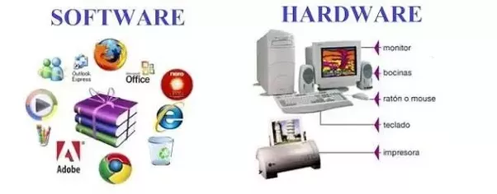
Software and Hardware
Computer hardware are the physical parts or components of a computer, such as the central processing unit, monitor, keyboard, computer data storage, graphic card, sound card and motherboard.
Software comprises of instructions that can be stored and ran by hardware.
Are they related?
Or are they two different
Disciplines?

Slide 3
Two sides of the “computation coin”
This seemingly disparate sub-disciplines of computer science, software and hardware, are intrinsically related.
Though in many schools there is an explicit marked separation and the single subject is organized for pedagogy and research as:
Computer Science
Computer Engineering

Slide 4

Micro-architectural Attacks: Design for Security
To quote Bruce Schneier, “Fixing them either requires a patch that results in a major performance hit, or is impossible and requires a re-architecture of conditional execution in future CPU chips. It shouldn't be surprising given that microprocessor designers have been building insecure hardware for 20 years. What's surprising is that it took 20 years to discover it."
Computer Architecture has been designed with performance as a primary design criteria.
Security has been an after thought.
For example:
Speculative execution is an optimization technique where a computer system performs some task that may not be needed.
This has been the basis of the recently discovered attacks: Spectre and Meltdown.
Reference: Spectre and Meltdown, Daniel Gruss, Moritz Lipp, Yuval Yarom, Paul Kocher, Daniel Genkin, Michael Schwarz, Mike Hamburg, Stefan Mangard, Thomas Prescher and Werner Haas, Google Ground Zero Project

Slide 5
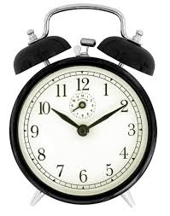
Timing Channels in Cryptography due to Cache Memories
Bob
(Cipher)
Secret
Key
(Adversary)
Microprocessor
Cache Memory
Alice
Monitor Time
Main Memory
Adversary wants to get Bob’s secret key
Why is “time” a channel for Information Leakage?
If there is a Cache Hit
Access time is less
If there is a Cache Miss
Access time is high

Slide 6
Time-Driven Cache Attack Principle
Part of a Cipher
(Adversary)
Table
Table
P₀
,P₄
If cache hit (less time) :
If cache miss (more time):
Notes:
Sbox is generally implemented as a table
6

Slide 7
Classes of Cache Attacks
Three ways to identify cache behavior
Cache Trace Attacks
Cache Access Attacks
Cache Timing Attacks

Slide 8
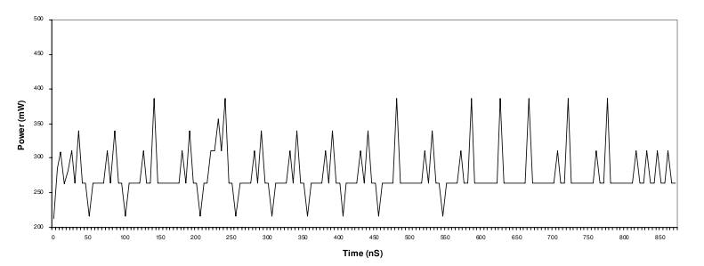
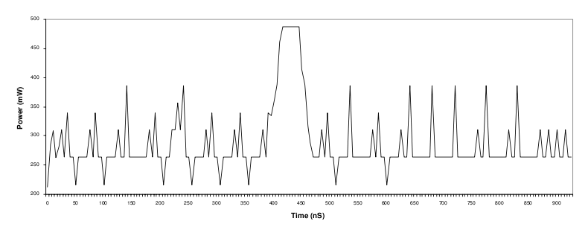
Cache Trace Attacks
The Power Profile of the system gives away cache behavior.
Without Cache Miss
With Cache Miss

Slide 9
Cache Access Attacks : Osvik’s Attack
Uses a spy program to determine cache behavior
Cache Memory
Part of the cache memory occupied by tables
Microprocessor
Cache Miss
Cache Hit
AES
Spy
Memory

Slide 10
Cache Timing Attack
Based on measuring the total time for encryption.
Used to attack a remote server.
Trigger Encryption &
Measure time taken
Network
Server running Encryption Software
Remote Attacker

Slide 11
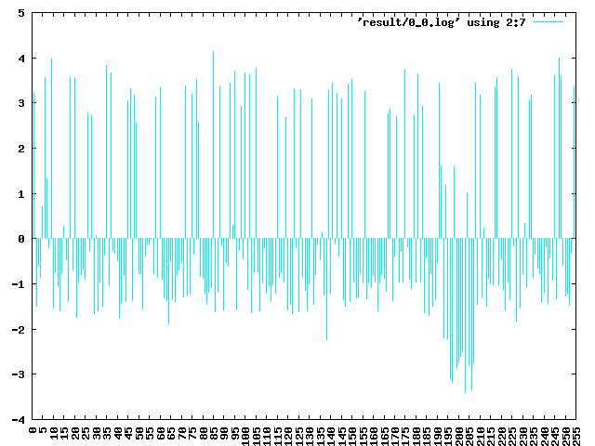

Bernstein’s Cache Timing Experiment
P0 = 00 - FF
Random
AES
Cipher Text
Characteristic of Plaintext Byte P₀
(Deviation from mean time)

Slide 12
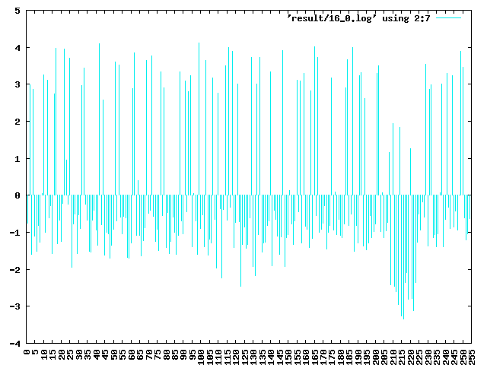
Bernstein’s Cache Timing Attack
Put key to all ZEROs and perform experiment
Repeat experiment with unknown key
Correlate the two results
12

Slide 13
Why Cache Attacks Work on AES
Substitute 16 bytes from a 256 byte lookup table
The AES Structure
Add initial Key
Nine Rounds of
Byte Substitution
Shift Row
Mix Column
Add Round Key
Final Round
Byte Substitution
Shift Row
Add Round Key
Chester Rebeiro, Mainack Mandal, Debdeep Mukhopadhyay, "Pinpointing Cache Timing Attacks on AES", VLSID 2010,

Slide 14
Software Implementations of AES(OpenSSL)
Merges all round operations into 4 lookups. Uses 4 tables T0, T1, T2, T4 , each of size 1024 byte.

Slide 15
Software Implementations of AES(OpenSSL) (contd.)
Each table has 256 entries of size 4 bytes. Thus each table is of 1 kB.
Since AddRoundKey can be implemented by additional 32 bit XOR, AES round can be implemented with 4 kB of tables, with 4 table look ups and one XOR per column per round.
Note that final round does not have a Mixcolumn step.

Slide 16
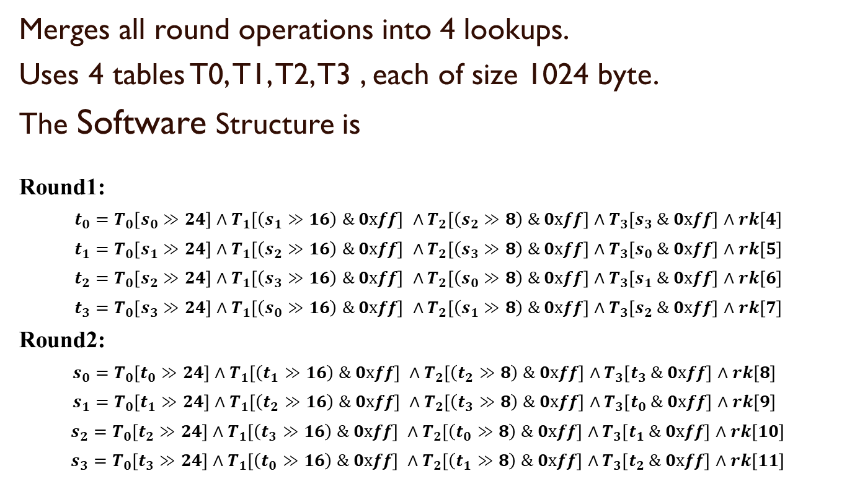
Software Implementations of AES (OpenSSL)

Slide 17
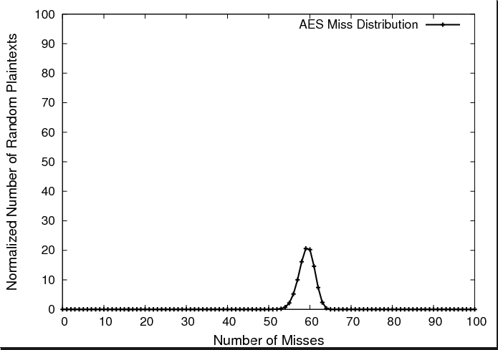
AES Execution Time for 4KB Table
Since, Nt = Nm + Nh
Cache Attack works because of varying execution time.

Slide 18
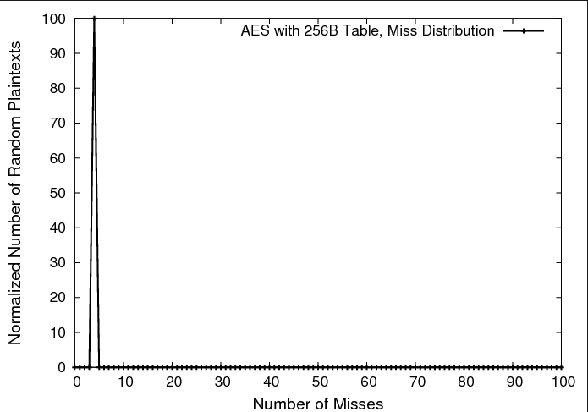
AES Execution Time with 256Byte Table
Cache Attacks
believed to be difficult
…… Encryption Time is a constant

Slide 19
Osvik’s Attack on AES-with 256B Table
Won’t Work!!!
Cache Memory
Microprocessor
AES
Spy
Memory

Slide 20
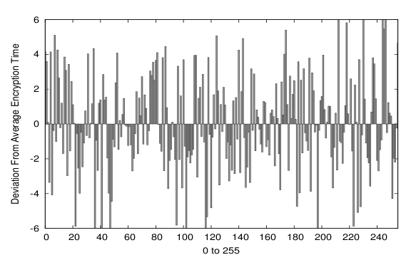
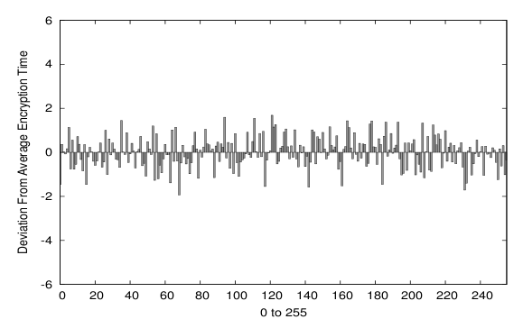
Bernstein’s Attack on Small Tables
Large
Tables
Lesser deviations in Encryption Time
Small
Tables

Slide 21
Some Opinions on Cache Timing Attacks
[Kelsey. et.al., 2000, Section 7]
“We believe attacks based on cache hit ratio in large Sbox ciphers like Blowfish, CAST and Khufu are possible”
We now show that cache attacks are possible even on ciphers with small sboxes
Chester Rebeiro, Debdeep Mukhopadhyay, Junko Takahashi and Toshinori Fukunaga, "Cache Timing Attacks on Clefia", Indocrypt 2009.

Slide 22
Analysis of Cache Timing Attacks
Processor’s aim : Reduce the miss penalty
Techniques used to achieve this are
Speculative Loading
Prefetching
Out-of-order loading
Parallelization
Overlapping

Slide 23
Speculative Loading
Speculative Loading :Loading of data into processor before preceding branches are resolved.
Effect on Cipher Execution :None, since branches are generally not used in block ciphers.

Slide 24
Out-of-Order Loading
Data accessed in an order not strictly specified by the program.
Program
Execution
LOAD AX, #1000
LOAD BX, #2000
LOAD CX, #3000
LOAD DX, #4000
LOAD DX, #4000
LOAD BX, #2000
LOAD AX, #1000
LOAD CX, #3000

Slide 25
Out-of-Order Loading on a Cipher
Round 1
S
S
S
S
S
S
S
S
S
S
S
S
S
S
S
S
Round 2
S
S
S
S
S
S
S
S
S
S
S
S
S
S
S
S
Out of order loading works only within a round & not between rounds.

Slide 26
Parallelization & Overlapping
Parallelization : Two or more cache misses are serviced simultaneously.
Overlapping : Memory reads are pipelined.
Effect on Cipher Execution :
Consider a 5 round block cipher with 4 misses
Time(E1) < Time(E2)
2 misses
1 miss
E1
1 miss
1 miss
1 miss
E2
1 miss
0 misses
0 misses
0 misses
1 miss

Slide 27
Extending Cache Timing Attack to Work on Small Table Ciphers
Challenges:
1. The deviation in encryption time is too less.
2. Timing measurements need to be more accurate.

Slide 28
Improvements to the Timing Attack (1)
Improving Timing Measurements
Use ‘RDTSC’ instruction to measure timing.
This is prone to errors due to processor pipeline and out-of-order execution.
Also use ‘CPUID’ before calling RDTSC
This flushes the processor pipeline.
Hence all RDTSC instructions done on a fresh pipeline.

Slide 29
Improvements to the Timing Attack (2)
P0
P1
P2
P3
K0
K1
K2
K3
XOR
XOR
XOR
XOR
S1
S2
S1
S2
Vary only those bytes which go to the same sbox as P0.
Constant
P0 = 00 - FF
Random
AES

Slide 30
Attack on CLEFIA
CLEFIA is a block cipher designed by Sony Corporation
It has small tables of 256 bytes.
There are 18 rounds in the cipher
each round has 8 look-ups
there are 2 S Boxes of 256 bytes
Thus there are 4 look-ups per S-box in each round.

Slide 31
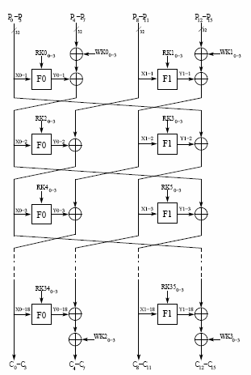
CLEFIA Attack Results
On Intel Core 2 Duo, the first phase of the attack takes 1300 seconds,
Second phase (with secret key) takes 312.5 seconds
The attack has also been tested successfully on
Pentium 4
Intel Atom
Xeon – Core 2 Server
The attack fails on Pentium 3
Chester Rebeiro, Debdeep Mukhopadhyay, Junko Takahashi and Toshinori Fukunaga, "Cache Timing Attacks on Clefia", Indocrypt 2009.

Slide 32
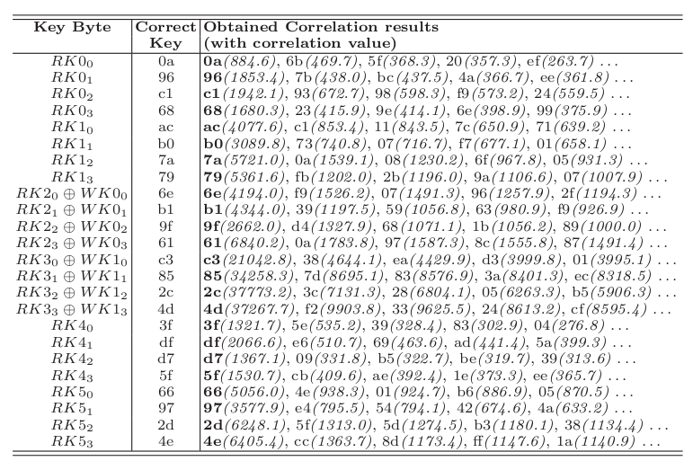
Correlation Results on CLEFIA
32

Slide 33
Part-III
Looking into Micro-architecture Attacks
: An Ideal Implementation for Cache Timing Attacks
Chester Rebeiro, Debdeep Mukhopadhyay:Micro-Architectural Analysis of Time-Driven Cache Attacks: Quest for the Ideal Implementation. IEEE Trans. Computers 64(3): 778-790 (2015)

Slide 34
Ideal Implementation against Time-Driven Cache Attacks
P₀
P₄
Random
Suppose
(K₀ = 00 and K₄ = 50)
P4 | Average Time | DOM
00 | 2945.3 | 1.8
10 | 2944.4 | 0.9
20 | 2943.7 | 0.2
30 | 2943.7 | 0.2
40 | 2944.8 | 1.3
50 | 2937.4 | -6.3
60 | 2943.3 | -0.2
70 | 2945.8 | 2.3
: | : | :
F0 | 2941.8 | -1.7
P₀ = 0, all other inputs are random
Make N time measurements
Segregate into Y buckets based on value of P₄
Find average time of each bucket
Find deviation of each average from overall average (DOM)
Block Cipher
Cipher Text
P₀
P₄
K₀
K₄
T
T
Average : 2943.57
Maximum : -6.3

Slide 35
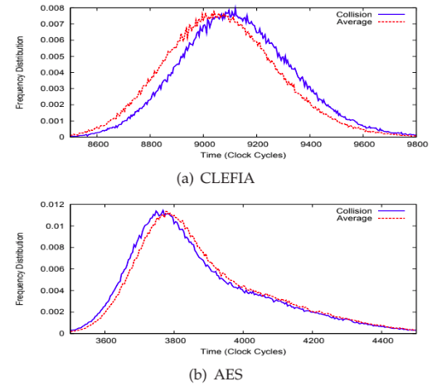
Different DOM for Different Implementations
Implementation | Difference of Means
AES (OpenSSL 0.9.8a ) | -6.5
DES (PolarSSL 1.1.1 ) | +11
CAMELLIA (PolarSSL 1.1.1) | 19.2
CLEFIA (Ref. Implementation 1.0) | 23.4
Easiness to attack

Slide 36
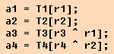
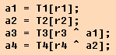
Effect of Micro-architecture in Cache Memory in Superscalar Processors
Snippet A
Snippet B
Assume the cache is clean before executing a snippet
Which is faster?
Snippet A !!!
In Superscalar processors cache misses can be
pipelined and parallelized provided there are no memory
dependencies

Slide 37
Which Implementation is Faster in a Superscalar Processor?
Snippet A
Snippet B
time
time
Cache misses in Snippet A can be
pipelined and parallelized

Slide 38
Memory Access in a Cipher
Round 1
T
T
T
T
T
T
T
T
T
T
T
T
T
T
T
T
Round 2
T
T
T
T
T
T
T
T
T
T
T
T
T
T
T
T
Round 1
Round 2
In a cipher, memory accesses within a round can
be parallelized and pipelined. But memory accesses
across rounds should be serialized

Slide 39
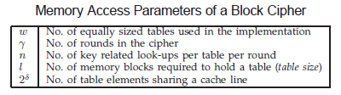
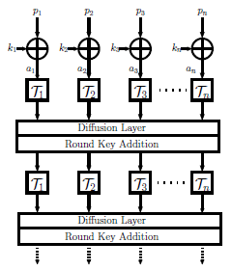
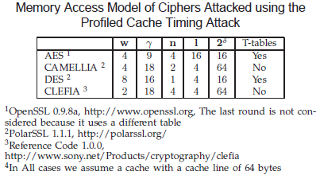
A Model for Block Cipher Implementations
Table Accesses

Slide 40
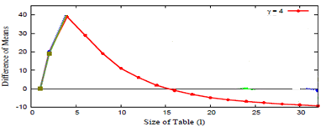
Ideal Implementation
Ideal
Micro-architectural features have a high influence on DOM
(such as in CLEFIA)
Table size influences
the DOM
(such as in AES)
Chester Rebeiro, Debdeep Mukhopadhyay:Micro-Architectural Analysis of Time-Driven Cache Attacks: Quest for the Ideal Implementation. IEEE Trans. Computers 64(3): 778-790 (2015)

Slide 41

Average Cache Misses per Round (m_{r})
Mathematical Model
Access/Round
Size of Tables
Round Number
Average
Cache Misses for the round
Cache Line Size

Slide 42

Average Time for Encryption
Average time for Round 1
Average time for Round 2
Average time for Round 3
Average time for Round 4
Total time for Encryption
Average time for Last Round

Slide 43
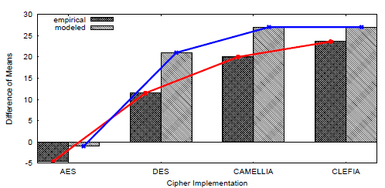
Comparing Cipher Implementations
Test Platform :
8 core Intel Xeon 2.13GHz
Depends on the executing core
Cipher Implementations
AES - OpenSSL (0.9.8ka)
DES - PolarSSL (1.1.1)
CAMELLIA - PolarSSL (1.1.1)
CLEFIA – Reference Code of Sony (1.0)

Slide 44
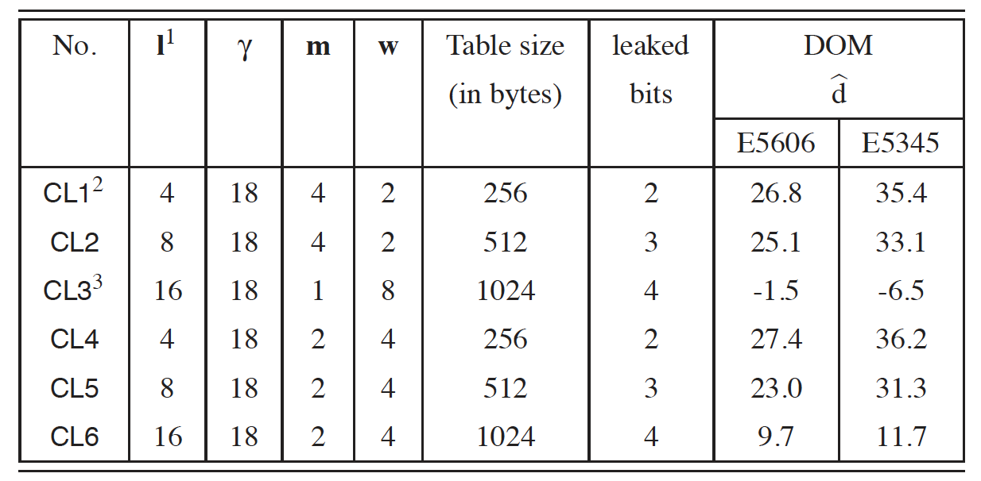
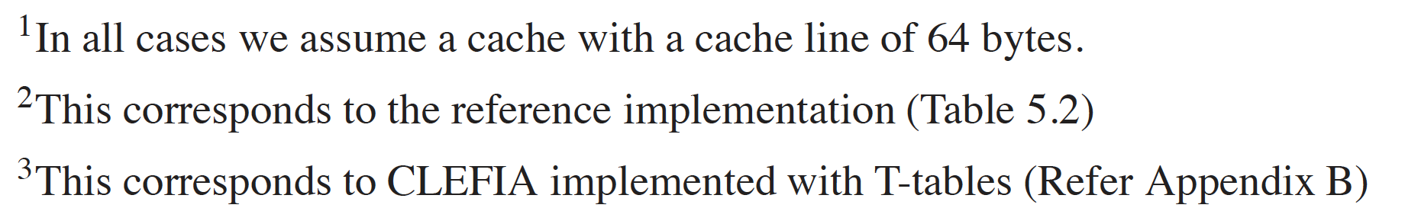
Different Avatars for Clefia

Slide 45
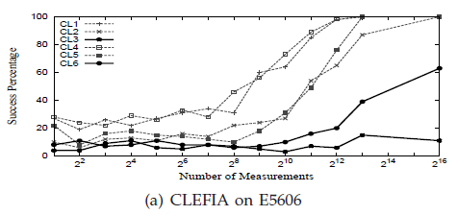
Practical Validations
Success of the Attack vs Number of Measurements Made
Implementations identified by
the mathematical model
are more difficult to attack

Slide 46
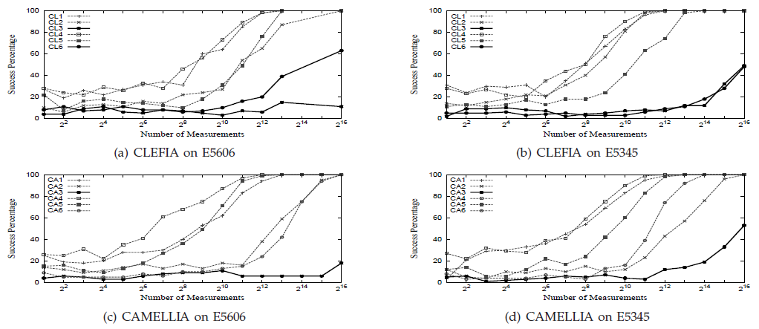
More Experiments
With CLEFIA and CAMELLIA on different platforms
Test platform E5606: Intel 8 core Xeon 2.13GHz, running Ubuntu 12.04
Test platform E5345 : Intel 4 core Xeon 2GHz, running Fedora OS

Slide 47
Two Sources of Leakage
In superscalar processors there are two sources of leakage
Leakage due to cache misses has a negative effect
Leakage due to micro-architectural features has a positive effect
Ciphers can be designed so that the two leakages cancel each other
This allows building implementations more protected against time-driven cache attacks

Slide 48
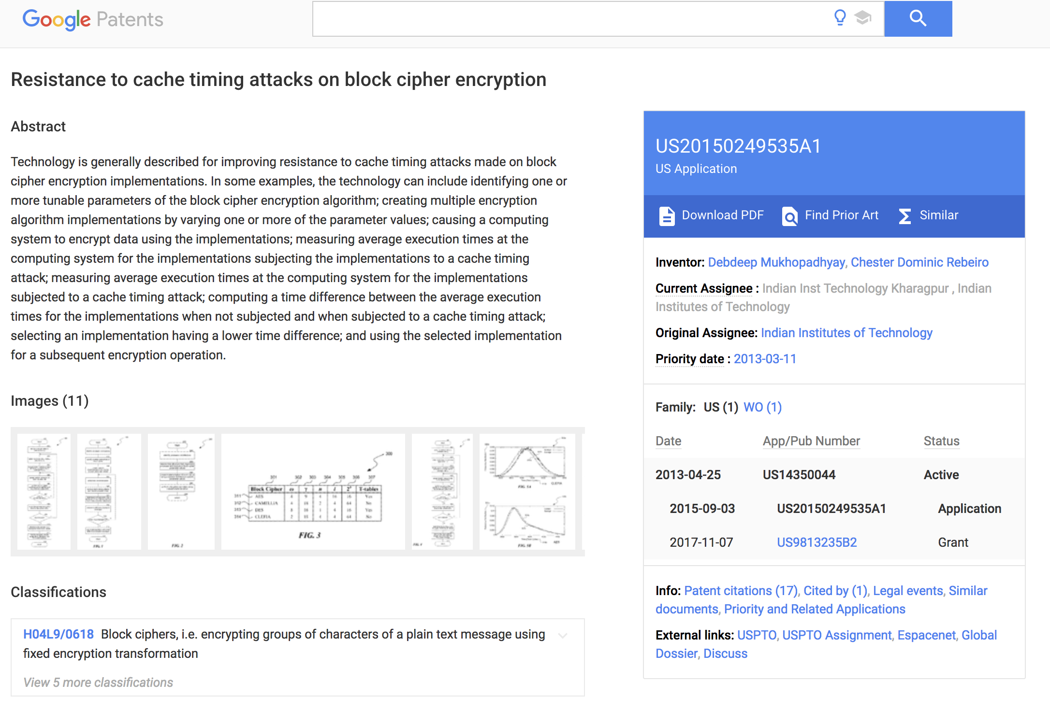
Patent

Slide 49

Part-IV
Modern Times:
Timing Attacks in Modern Systems

Slide 50
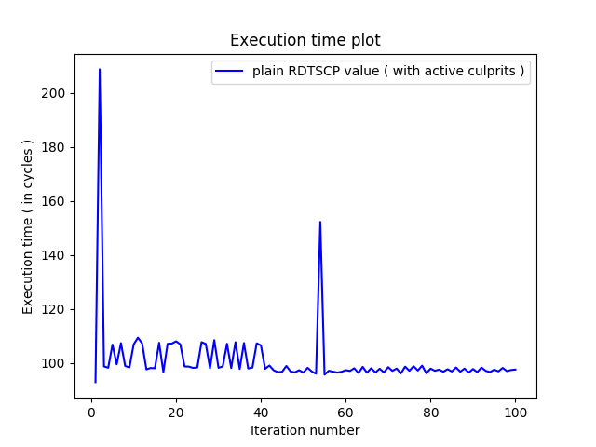
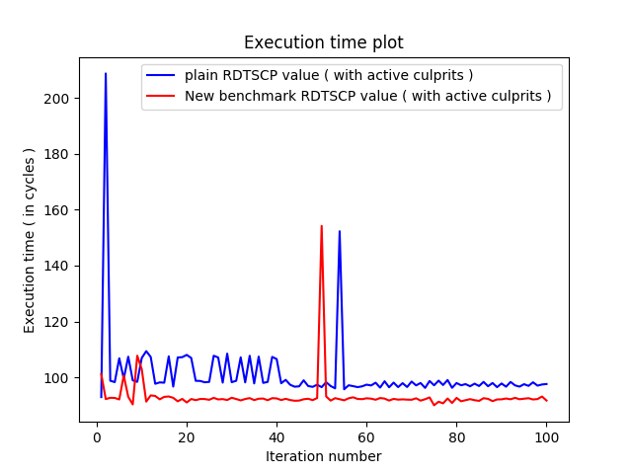
Timing Attack in Modern Systems
In modern day systems timing attack faces difficulties because of the modifications for performance improvements.
Timing measurements for the execution of a same instruction with RDTSCP creates different timing values at different instances.
New RDTSCP benchmark code generates similar timing measurements.

Slide 51
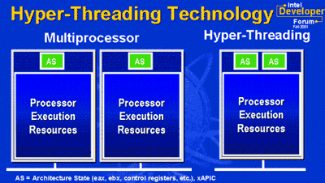
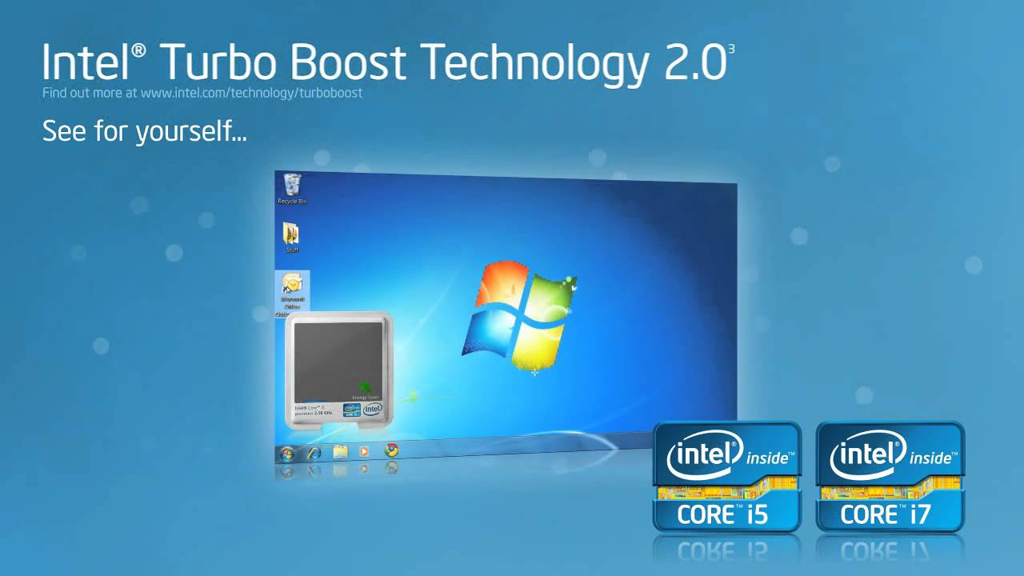

Timing Attack in Modern Systems
Nondeterminism
(performance improvements)
eliminate
disable
disable
Can be done from USER space
disable
Requires ROOT ACCESS

Slide 52
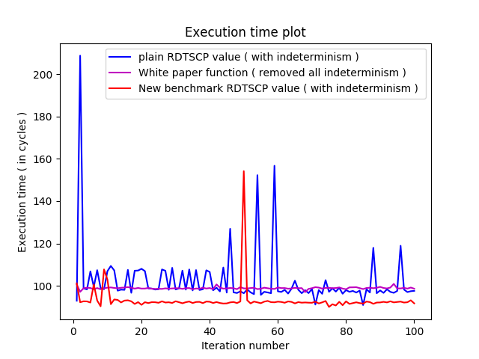
Timing Attack in Modern Systems
How to Benchmark Code Execution Times on Intel® IA-32 and IA-64 Instruction Set Architectures - Gabriele Paoloni (White Paper)
Removes all Nondeterminism
(with root access)

Slide 53
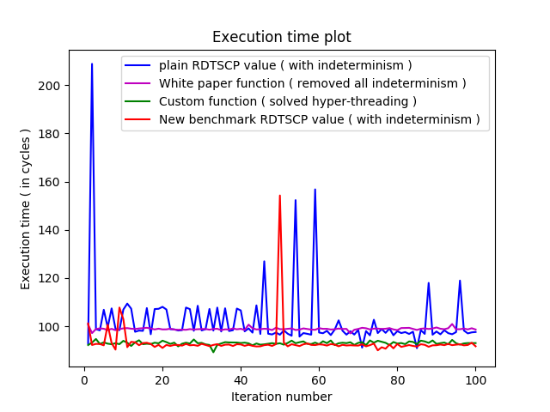
Timing Attack in Modern Systems
Eliminate nondeterminism due to hyper-threading from user space
Spy thread keeps one virtual core occupied and lets other thread run solely on other virtual core
Core
Virtual Core 0
Virtual Core 1
Spy thread
while(1){;}
Time measurement thread
start = time_fn()
/*function*/
end = time_fn()
timing = end - start

Slide 54
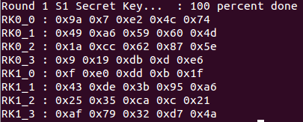
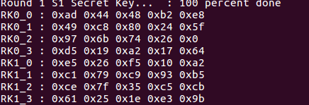
Timing Attack in Modern Systems
Timing Attack on Modern System (Core i5)
Accuracy 0%
After Removing all Indeterminism
Accuracy around 60%

Slide 55
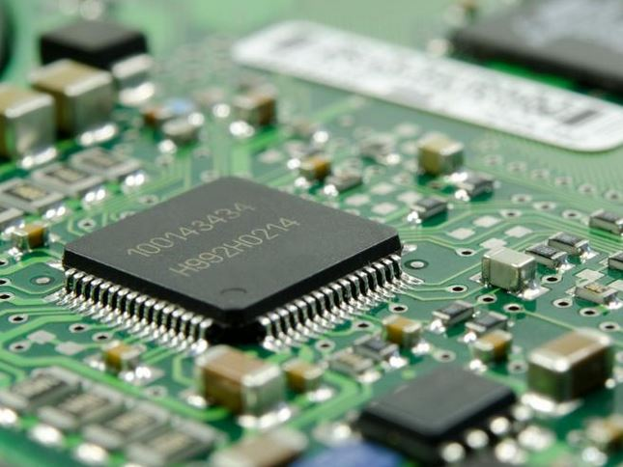
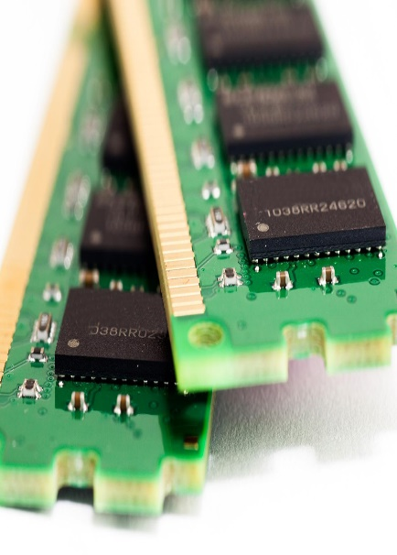
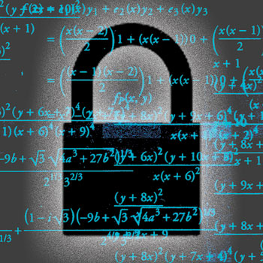
Timing Analysis for Row Hammering
Cache Memory
Cache Miss
DRAM
Crypto execution

Slide 56
Timing Analysis for Row Hammering
Slice 0
Slice 1
Slice 2
Slice 3
Copies data to indexed cache set and slice
Rank
Banks
DRAM access on cache miss
Rows

Slide 57

Timing Analysis for Row Hammering
Spy fills the cache sets with its own data
Once data in cache, access to same data results in Cache Hit
Slice 0
Slice 1
Slice 2
Slice 3
Next access results in Cache Miss
Concurrent accesses to DRAM banks to enforce rowbuffer collision
Rank
Banks
Access to DRAM on cache misses imposed by spy
Rows

Slide 58


New Frontiers of Micro-Architectural Attacks
.
Jump over ASLR
CacheBleed
Bypass existing Address Space Layout Randomization schemes by exploiting a side-channel created through shared BTB
Targets OpenSSL 1.0.2f RSA modular exponentiation on Intel processors using cache bank conflict

Slide 59



New Frontiers of Micro-Architectural Attacks
Exploiting Speculative Execution
01
Spectre: uses branch misprediction and out-of-order execution to access unprivileged data.
02
Meltdown: uses out-of-order execution and prime-probe method to access kernel pages
03
Foreshadow: uses L1TF and page fault along with meltdown to retrieve data across SGX enclaves.

Slide 60
Conclusions
Micro-architectural attacks encompasses the intersection of architecture and computer security.
Architectures have been developed to enhance performance:
Cache memories
Prefetchers
Out of order execution
However leakage due to architecture is not yet a guideline for design.
More attacks are emerging and security is getting to be a game changer: Design-for-Security along with other objectives like performance, power, energy.
Good time to think of clean paper designs for secured computer architecture
RISC-V is a good open source platform to experiment.

Slide 61

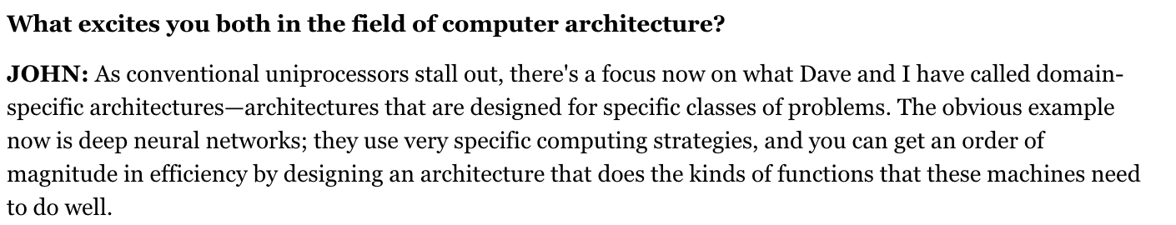
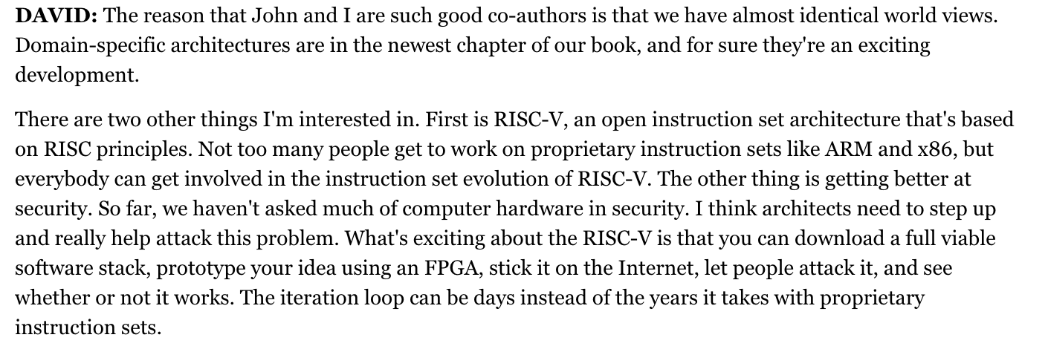
Thank You for your attention!!
Ref: Viewpoint, By Leah Hoffmann Communications of the ACM, June 2018, Vol. 61 No. 6, Pages 104-ff10.1145/3204453 .

Slide 62


Proceedings in Springer LNCS
Please visit us at: https://www.isical.ac.in/~space2019/index.html

Slide 63

Textbook on Hardware Security
"… an excellent job introducing the field of hardware security. It is a good source for upper undergraduates, postgraduates, and practitioners. The book does not need to be read cover to cover, and a select subset of chapters can form an undergraduate or graduate course in hardware security. … an excellent reference and can help graduate students move quickly to the frontiers of research. With its 432 references, the book helps direct readers who want to explore a specific topic in more detail."
—Computing Reviews, April 2015
Mentioned in the global bestseller list for 2015:
http://reviews.libraryjournal.com/2015/05/best-sellers/computer-science-may-2015-best-sellers/

Slide 64

Text Book on Timing Attacks
Discusses various timing attack algorithms in detail allowing readers to reconstruct the attack.
Presents the application of timing attacks on remote systems and cloud environments.
Examines information leakage models that would help quantify leakage in a covert timing channel

Slide 65
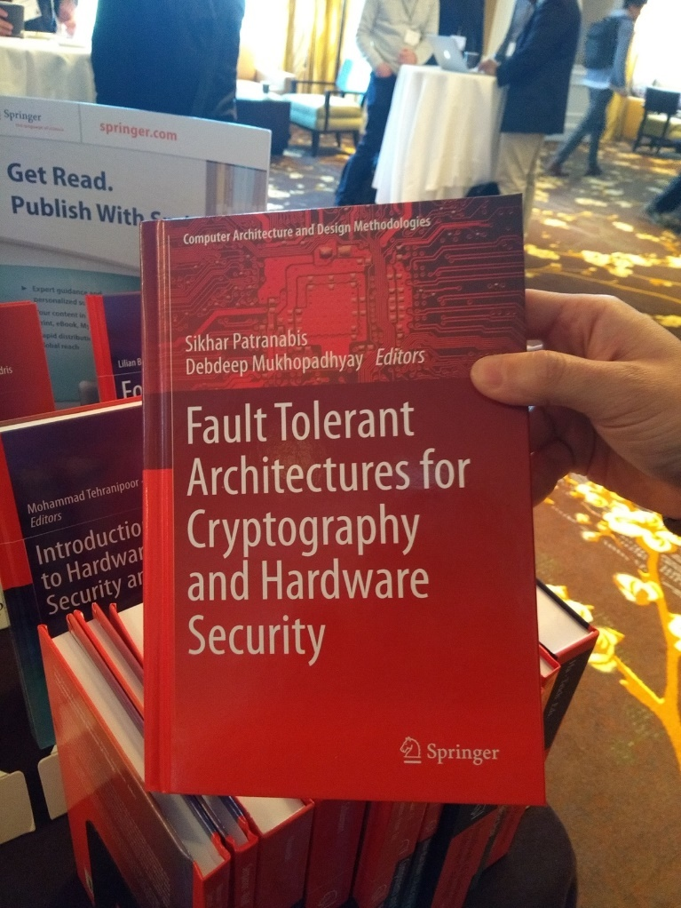
Text Book on Fault Attacks
Reviews exhaustively the recent key research into fault tolerant architectures in hardware security and cryptography software
Discusses the latest fault attacks on a wide variety of cryptographic implementations, such as biased fault attacks, algebraic fault attacks, and attacks on authenticated encryption based ciphers
Offers hands-on and practical demonstrations for handling complex secure cryptographic architectures, complementing the theoretical analysis

Slide 66
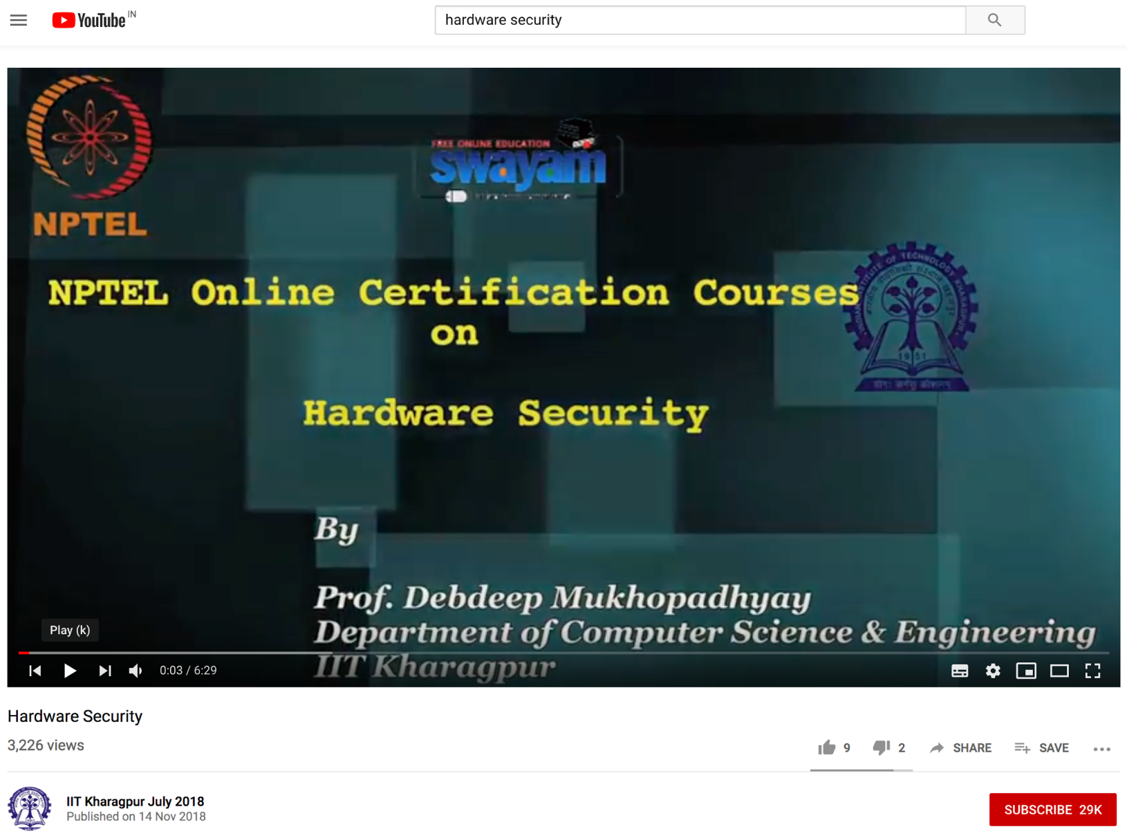
MOOC Course on Hardware Security
https://www.youtube.com/watch?v=xwgecIX3E4I&list=PLbRMhDVUMngfulSvKL0cT-tn8ULtERsWk&index=1

